Slide 1
Bispecific T-Cell Engagers (BiTEs) in Hematologic Malignancies
Grand Rounds
January 6, 2023

Slide 2
Disclosures
None

Slide 3
Learning Objectives
Identify the need for accessible T effector cell immunotherapy in the treatment of relapsed/refractory DLBCL, FL, and MM
Dissect the dosing regimens, CRS prophylaxis strategies, efficacy, and toxicity in four phase 2 BiTE trials published in 2022
Compare the outcomes with BiTEs to CAR-T cell therapy in lymphoma and myeloma

Slide 4
Impact of commercial CAR-T wait times
CIBMTR analysis of commercial Axi-cel (n=1383)
UAMS/MCW wait list data for commercial Ide-cel (n=80)
ASH 2022 Abstract 3345; ASH 2022 Abstract 3588

Slide 5
Overview
Background: the success of blinatumomab (CD19xCD3 BiTE) in ALL
Lymphoma (CD20xCD3 BiTEs)
Glofitamab NEJM 12/15/22
Epcoritamab EPCORE NHL-1 JCO 12/22/22
Ondronextamab ELM-2 ASH 2022 ABSTRACTS 444 & 949
Mosunetuzumab Lancet Oncol 8/23/22; FDA APPROVED 12/22/22 for 3L R/R FL
Myeloma
Teclistamab (BCMAxCD3 BiTE) MagisTEC-1 NEJM 8/11/22; FDA APPROVED 10/25/22 for 5L R/R MM
Talquetamab (GPRC5DxCD3 BiTE) MonumenTAL-1 NEJM 12/15/22
Cevostamab (FcRH5xCD3 BiTE) unpublished

Slide 6
The success of Blinatumomab
Derived from the term B lineage-specific anti-tumor mouse monoclonal antibody
FDA approved for R/R Ph- B-ALL in 2014, then for Ph- B-ALL in MRD+ CR1 or CR2 in 2018
Downside: small molecule with resultant short half life → requires continuous infusion

Slide 7
CD20xCD3 BiTEs in Non-Hodgkin Lymphomas

Slide 8
Non-Hodgkin Lymphoma Subtypes
5.6 per 100k per year
~18,500 new cases per year
2.6 per 100k per year
~8,600 new cases per year
JCO 1998 Aug;16(8):2780-95, seer.cancer.gov

Slide 9
CD20xCD3 BiTEs: trial vs publication histology
Glofitamab
NCT03075696: “…Relapsed/Refractory B-Cell Non-Hodgkin's Lymphoma”
Inclusion: a histologically-confirmed hematological malignancy that is expected to express CD20
Exclusion: CLL, Burkitt’s, LPL, PCNSL
Dickinson et al. NEJM 2022: DLBCL, HGBL, PMBL, tFL
Epcoritamab
NCT03625037: “…Relapsed, Progressive or Refractory B-Cell Lymphoma”
Inclusion: Documented CD20+ mature B-cell neoplasm (DLBCL, HGBL, PMBL, FL, MCL, SLL, MZL)
Exclusion: PCNSL or CNS involvement
Thieblemont et al. JCO 2022: DLBCL, PMBL, HGBL, FL G3b
Mosunetuzumab
NCT02500407: “…Non-Hodgkin's Lymphoma (NHL) and Chronic Lymphocytic Leukemia (CLL)”
Inclusion: B-cell hematologic malignancies expected to express CD20
Exclusion: CNS lymphoma
Budde et al. Lancet Oncol. 2022: FL G1-3a
Notes:
Almost anyone with CD20 and a pulse

Slide 10
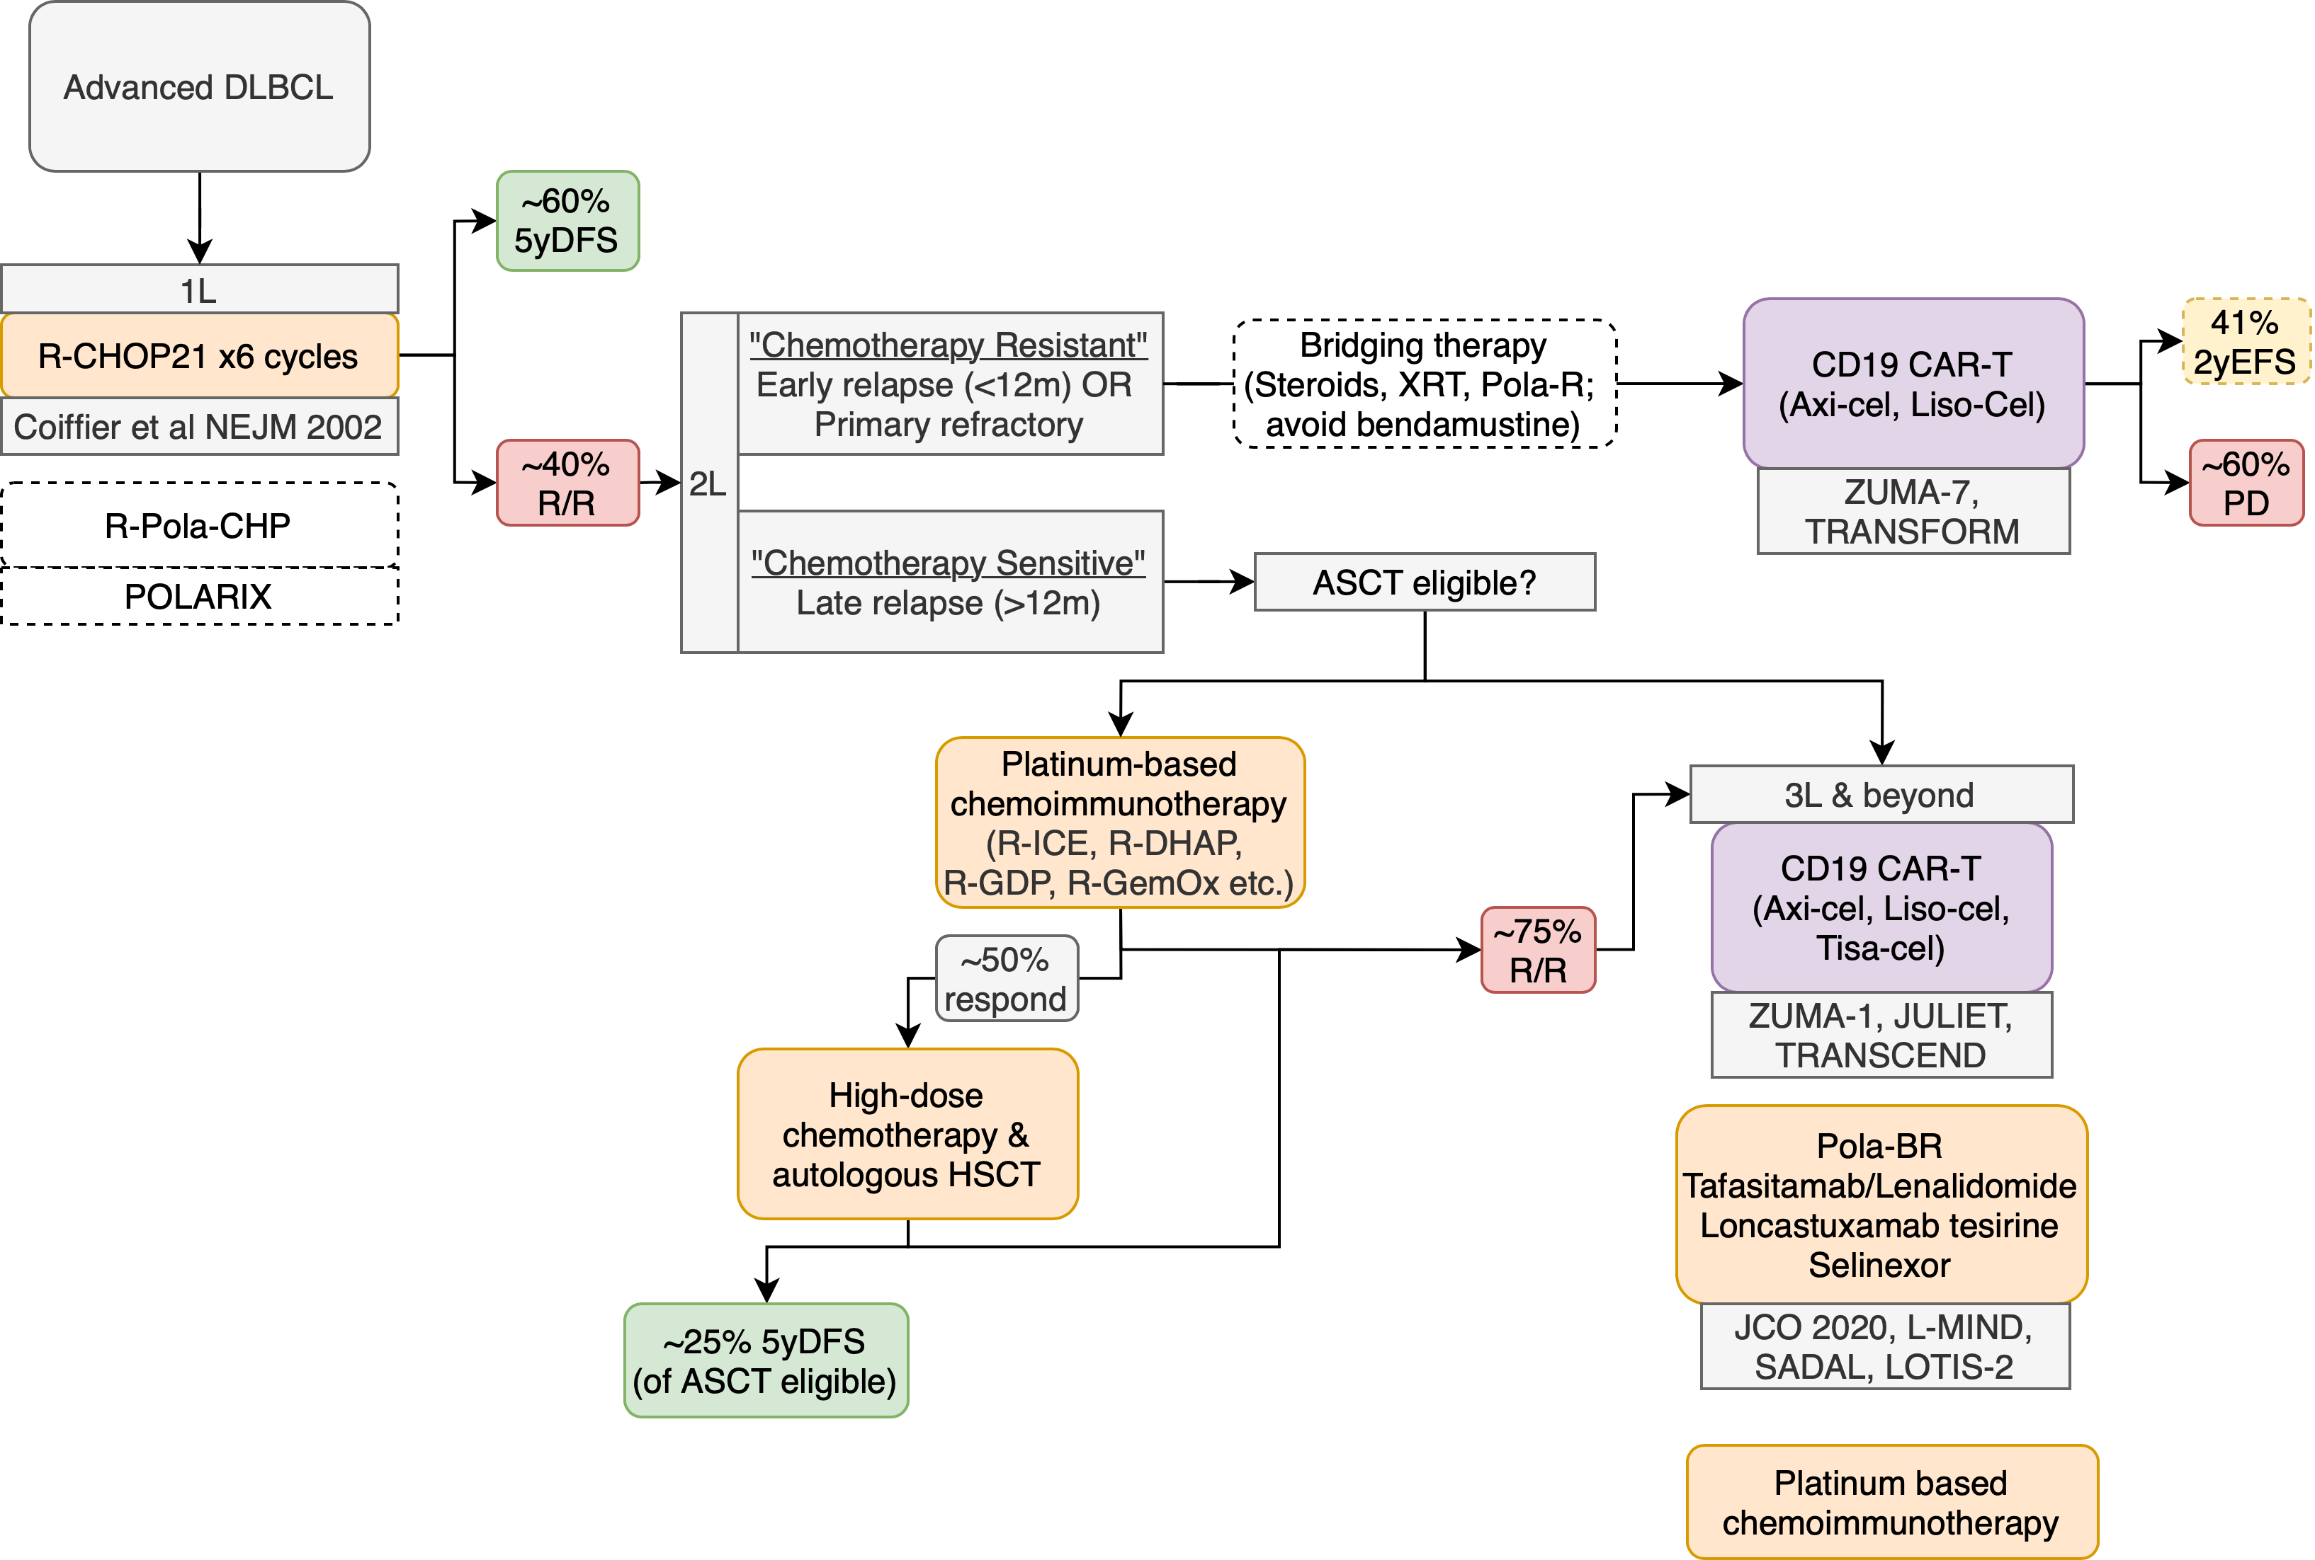
DLBCL treatment

Slide 11
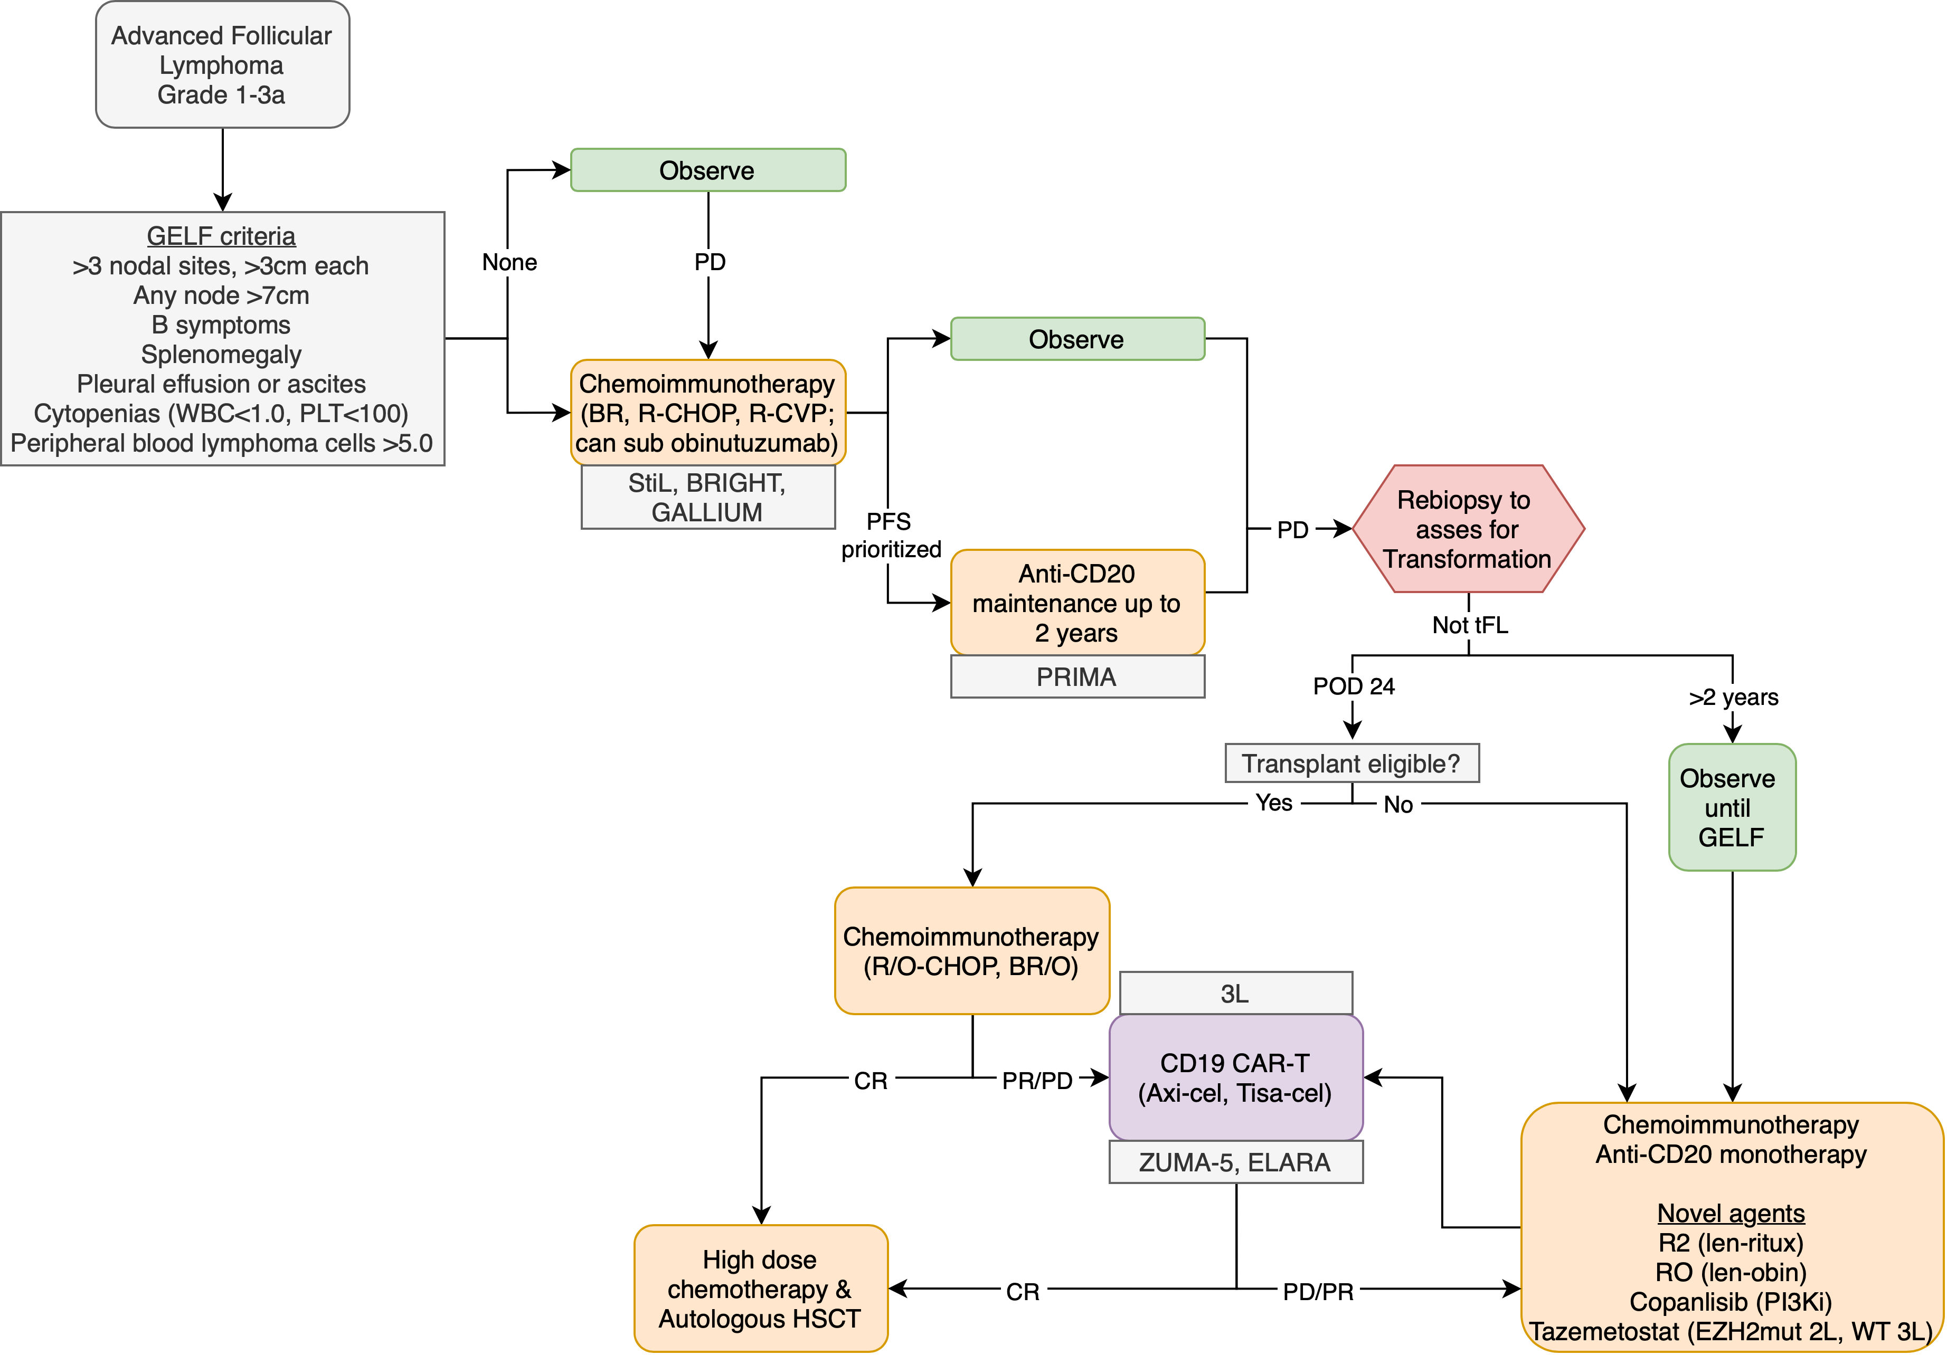
FL treatment

Slide 12
CD19 CAR-T
CD20xCD3 BiTEs
No prior CD19 targeted therapy or T effector cell therapy
Required prior CD20 therapy
30-40% prior CAR-T therapy in aggressive B-cell lymphoma trials

Slide 13
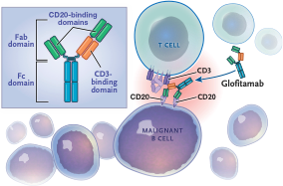
CD20xCD3 BiTEs
Glofitamab (bivalent)
Epcoritamab & Mosunetuzumab
Meaningful or marketing?
NEJM 2022; 387:2287-2290.

Slide 14
CD20xCD3 BiTE trials
 | Glofitamab | Epcoritamab |  | Mosunetuzumab
Diagnosis | DLBCL, tFL, HGBL, PMBL | DLBCL, FL G3b, HGBL, PMBL |  | r/r FL G1-3a
Line | 3L | 3L |  | 3L
Required prior therapy | anti-CD20 and anthracycline | anti-CD20 and prior or ineligible for ASCT |  | anti-CD20 and alkylating agent
Phase | 2 | 2 |  | 2
Duration of therapy | Fixed | Continuous |  | Fixed
Route | IV | SQ |  | IV

Slide 15
Dosing Regimens, CRS ppx, and hospitalization
Glofitamab IV
Fixed duration, twelve 21-day cycles
Cycle 1 (step-up dosing)
Day 1: Obinutuzumab 1000mg IV
Day 8: Glofitamab 2.5mg IV
Day 15: Glofitamab 10mg IV
Cycles 2 to 12
Day 1: Glofitamab 30mg IV
Supportive Care:
Methylprednisolone 80mg IV or equivalent cycles 1 and 2
Optional in later cycles unless develops CRS
Acetaminophen 500-1000mg
Diphenhydramine 50-100mg
Hospitalized for first dose of Glofitamab, outpatient for subsequent doses unless G2 or higher CRS with first
Epcoritamab SC
Indefinite therapy, 28-day cycles
Cycle 1 (step-up dosing)
Day 1: Epcoritamab 0.16mg SC priming dose
Day 8: Epcoritamab 0.8mg SC intermediate dose
Days 15 and 22: Epcoritamab 48mg SC full dose
Cycles 1 to 3: Epcoritamab 48mg SC weekly (days 1, 8, 15, 22)
Cycles 4 to 9: Epcoritamab 48mg SC every two weeks (days 1, 15)
Cycle 10 and beyond: Epcoritamab 48mg SC (day 1)
Supportive Care:
Prednisolone 100mg PO daily x4 for each dose of cycle 1 (days 1-4, 8-11, 15-18, and 22-25)
If grade 2 or higher CRS after 4th dose of cycle 1, corticosteroids were given x4 days for each dose until CRS resolved
Diphenhydramine 50mg
Acetaminophen 650-1000mg
Hospitalized 24h after 3rd dose (first full dose)
Mosunetuzumab IV
Fixed duration, up to seventeen 21-day cycles
Cycle 1 (step-up dosing)
Day 1: Mosunetuzumab 1mg IV
Day 8: Mosunetuzumab 2mg IV
Day 15: Mosunetuzumab 60mg IV
Cycle 2
Day 1: Mosunetuzumab 60mg IV
Cycle 3 onwards (to cycle 8 if CR, cycle 17 if PR/SD)
Day 1: Mosunetuzumab 30mg IV
Supportive care:
Corticosteroids (MP 80mg IV or Dex 20mg IV) cycles 1 and 2
Optional from cycle 3 on
Hospital admission not mandatory

Slide 16
Baseline Characteristics
 | Glofitamab | Epcoritamab
Enrollment | 1/2020 to 9/2021 | 6/2020 to 1/2022
Data Cutoff | 3/14/22 | 1/31/22
N | 154 | 157
Age | 66 (21-90) | 64 (20-83)
Sex | 65%M/35%F | 60%M/40%F
Median prior LOT | 3 (2-7) | 3 (2-11)
Diagnosis | 71% DLBCL 18% tFL 7% HGBL 4% PMBL | 89% DLBCL (28% transformed) 6% HGBL 2% PMBL 3% FL3b
 | Mosunetuzumab
Enrollment | 5/2019 to 9/2020
Data Cutoff | 8/27/21
N | 90
Age | 60 (53-67)
Sex | 61%M/39%F
Median prior LOT | 3 (2-4)
Prior therapy | 100% alkylator 100% anti-CD20 82% anthracycline 19% PI3Ki 14% IMiD
Primary refractory | 58% | 61%
Prior CAR-T | 33% | 38.9% (75% progressed <6m)
Prior ASCT | 18% | 19.7% (58% relapse <12m)
POD24 | 52%
Prior CAR-T | 3%
Prior ASCT | 21%

Slide 17
Outcomes
 | Glofitamab | Epcoritamab
Median f/u | 12.6 months | 10.7 months
1º | CR | ORR
ORR | 52% | 63%
CR | 39% | 39%
Mosunetuzumab
18.3 months
CR
80%
60%
Median time to response | n/a | 1.4 months (1.0-8.4)
Median time to CR | 42 days (31-308) | 2.7 months (1.2-11.1)
Duration of CR | 78% at 12 months | 89% at 9 months
Other |  | MRD (-) 45.9% (49 of 107 evaluable by clonoSEQ) 78% remained MRD (-) at 6 months
1.4 months (1.2-2.9)
3.0 months (1.4-5.7)
63.7% at 18 months
Treatment cycles received <8 cycles - 23% 8 cycles - 59% 8-17 cycles - 6% 17 cycles - 12%

Slide 18
Toxicity: CRS/ICANS
 | Glofitamab | Epcoritamab |  | Mosunetuzumab
Any CRS | 63% | 49.7% |  | 44%
G1-2 CRS | 60% | 47.1% |  | 26%/17%
G3-4 CRS | 2.6%/1.3% | 2.5%/0% |  | 1%/1%
G5 CRS | none | none |  | none
Any ICANS | 8% | 6.4% |  | 3%
G3-4 ICANS | 2.6% | 0% |  | 0%
G5 ICANS | none | 1 event |  | none
Anti-IL6 | 20% | 28% |  | 32.5% received either (8% tocilizumab alone, 15% steroids alone, 10% both)
Unplanned steroids | 18% | 20%
Unplanned hospitalization | 7% ICU admission | n/a |  | 23%

Slide 19
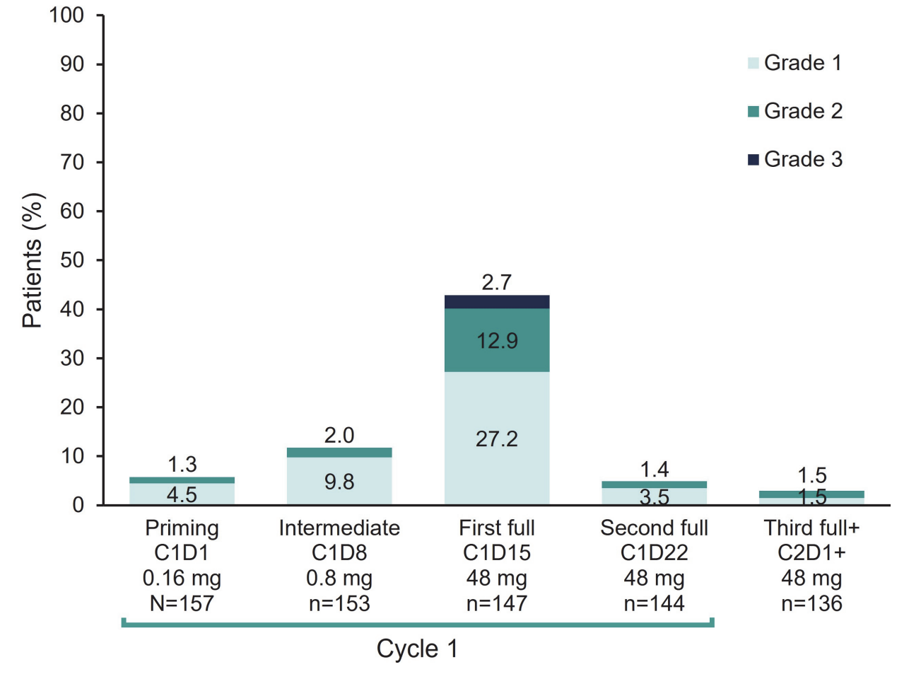
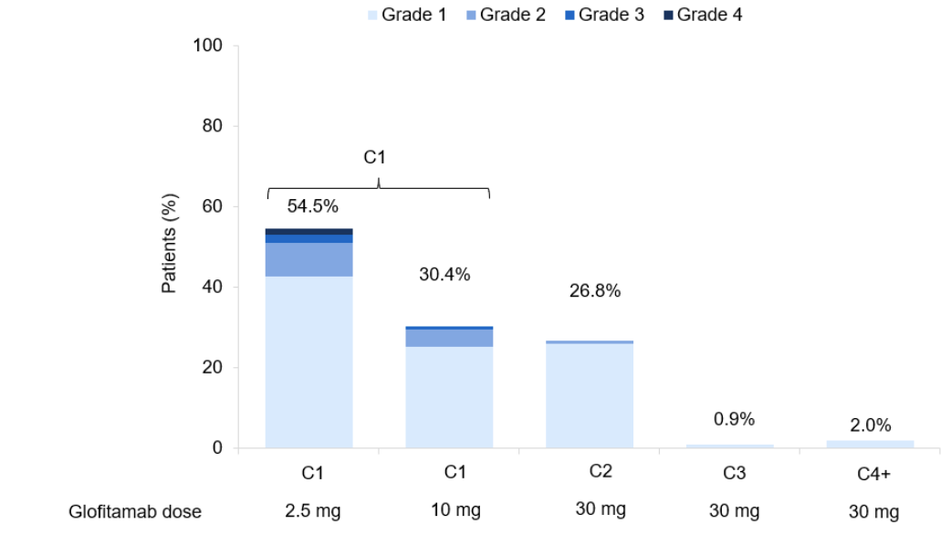
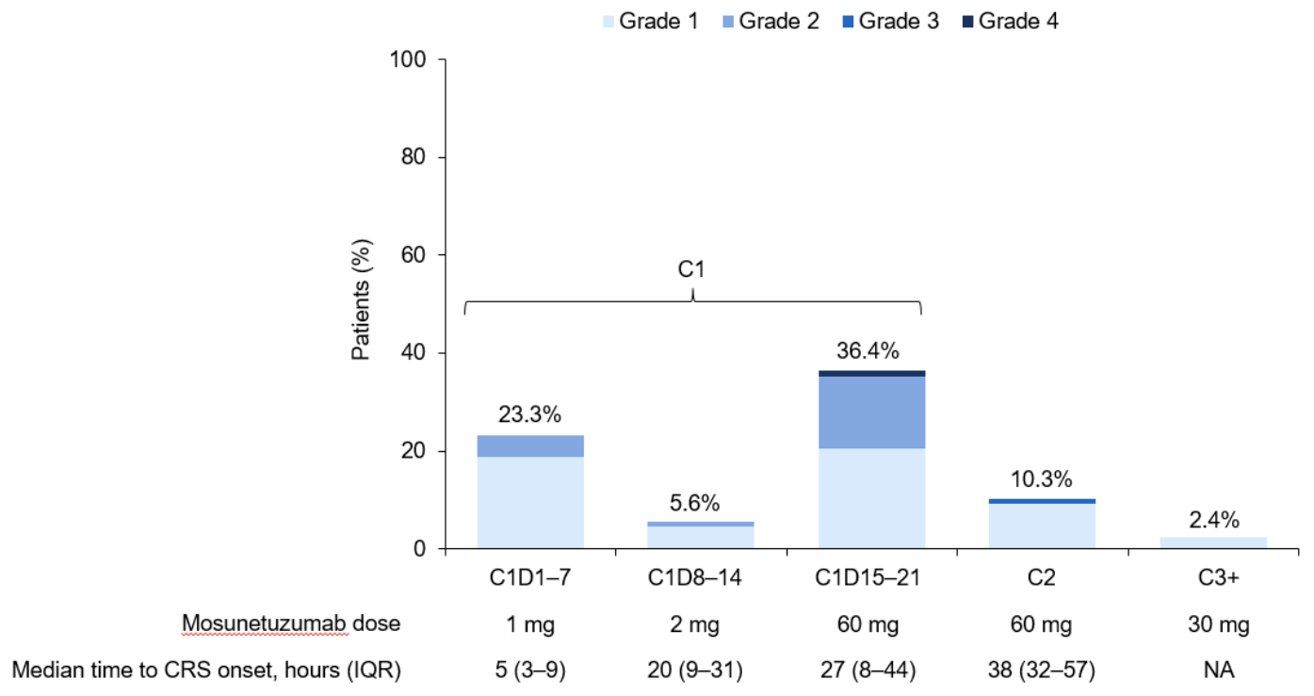
CRS timing
Mandated hospitalization
Epcoritamab
No mandated hospitalization
Mandated hospitalization

Slide 20
Toxicity: Hematologic/Infectious
 | Glofitamab | Epcoritamab |  | Mosunetuzumab
G3-4 Anemia | 6% | 10% |  | 8%
G3-4 Thrombocytopenia | 8% | 6% |  | 4%
G3-4 Neutropenia | 27% | 15% |  | 27%
G-CSF | n/a | 10% |  | 20%
Febrile Neutropenia | 3% ≥G3 | 3% |  | n/a
Infection | 38% (15% G3-4) | 14.6% (1.3% G3-4) |  | 20% (14% G3-4)
COVID19 | 2.6% (1.3% G5) | 6.4% (1.3% G5) |  | 4% (no G5)
Any G5 AE | 5% (0 of 8 attributed to glofitamab) | ? At least 1 |  | 2.2% (0 of 2 attributed to mosunetuzumab)
Other | 6% G3-4 hypophosphatemia | n/a |  | 8% G3-4 hyperglycemia 17% G 3-4 hypophosphatemia 8% anemia

Slide 21
DLBCL CD19 CAR-T and CD20xCD3 BiTEs
 | DLBCL
 | Axi-cel |  | Liso-cel |  | Tisa-cel |  | Glofitamab | Epcoritamab
Trial | ZUMA-7 | ZUMA-1 | TRANSFORM | TRANSCEND | BELINDA | JULIET | NEJM 2022 | EPCORE NHL1
Target | CD19 | CD19 | CD19 | CD19 | CD19 | CD19 | CD20xCD3 | CD20xCD3
Line of therapy | 2L | 3L | 2L | 3L | 3L | 3L | 3L | 3L
Phase | 3 | 2 | 3 | 2 | 3 | 2 | 2 | 2
N | 359 | 111 | 184 | 256 | 322 | 93 | 154 | 157
ORR | 83% | 82% | 86% | 73% | 46% | 52% | 52% | 63%
CR | 65% | 54% | 61% | 53% | 28% | 40% | 39% | 39%
Any CRS (≥G3) | 92% (6%) | 93% (13%) | 49% (1%) | 42% (2%) | 61% (5%) | 57% (23%) | 63% (4%) | 50% (3%)
ICANS (≥G3) | 60% (21%) | 64% (28%) | 12% (4%) | 30% (10%) | 10% (2%) | 20% (11%) | 8% (3%) | 6% (0%)

Slide 22
FL CD19 CAR-T and CD20xCD3 BiTEs
 | FL
 | Axi-cel | Tisa-cel | Mosenutuzumab
Trial | ZUMA-5 | ELARA | Lancet Oncol 2022
Target | CD19 | CD19 | CD20xCD3
Line of therapy | 3L | 3L | 3L
Phase | 2 | 2 | 2
N | 86 | 90 | 90
ORR | 94% | 86% | 80%
CR | 79% | 69% | 60%
Any CRS (≥G3) | 78% (6%) | 53% (0%) | 44% (2%)
ICANS (≥G3) | 59% (19%) | 4% (1%) | 3% (0%)

Slide 23
BiTEs in Multiple Myeloma

Slide 24
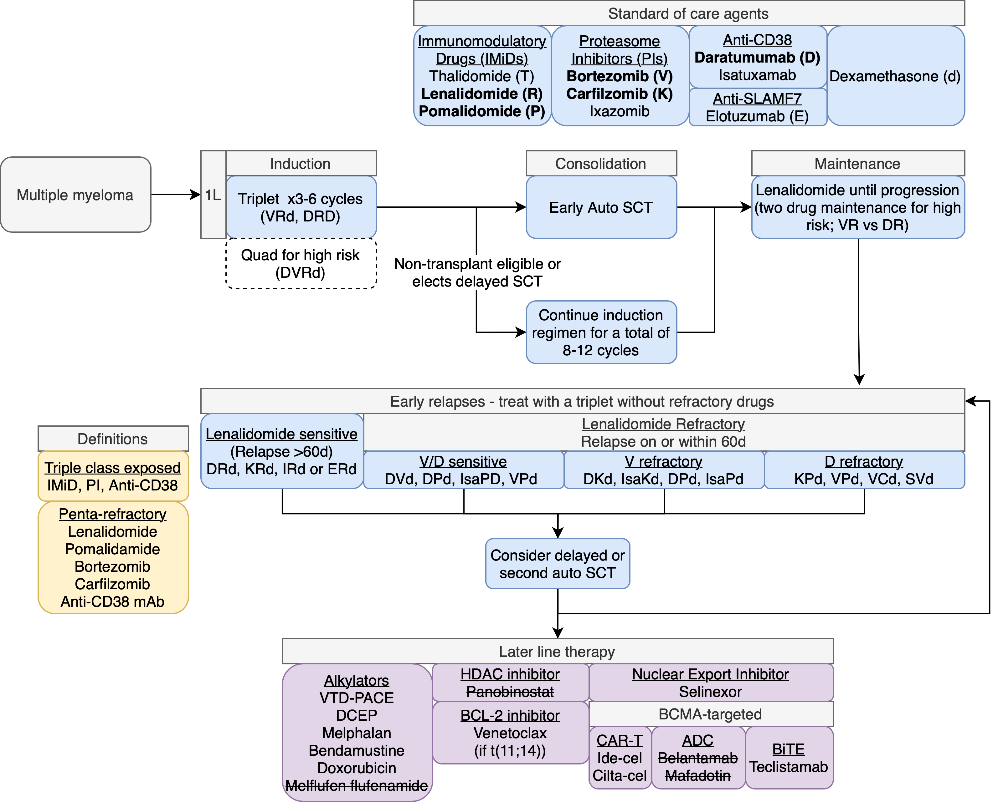
Myeloma treatment

Slide 25
LocoMMotion study
Prospective, non-interventional study of triple-class exposed R/R MM (N=248)
ECOG 0-1
Leukemia. 2022 May;36(5):1371-1376

Slide 26
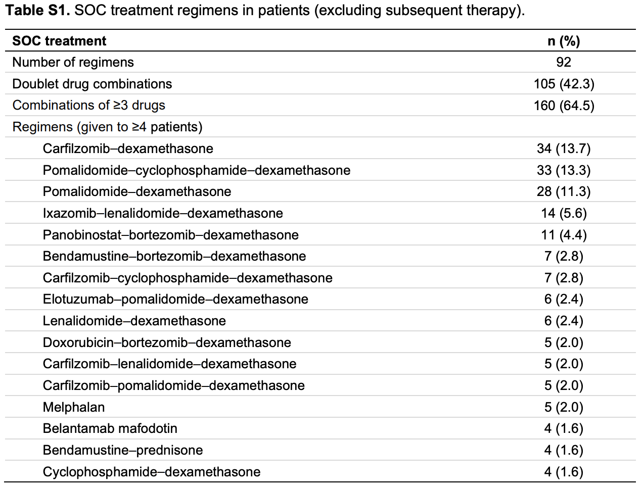
LocoMMotion study
ORR 29.8%
Only one CR and no stringent CR
mPFS 4.6 months
3.9 months in triple-class refractory vs 8.2 months in triple-class exposed
mOS 12.4 months
Leukemia. 2022 May;36(5):1371-1376

Slide 27
Caution with MM accelerated approvals
Standard of Care
Withdrawn
2003 Bortezomib
2012 Carfilzomib
2013 Pomalidomide
2015 Daratumumab
2015 Panobinostat
2/2015 accelerated approval based on phase 3 PANORAMA 1 trial (PFS benefit, nonsignificant OS benefit)
11/2021 withdrawn after “not feasible to complete” confirmatory trial
2020 Belantamab Mafadotin
8/2020 accelerated approval based on phase 2 DREAMM-2 trial (single agent ORR 31%)
11/2022 withdrawn after phase 3 DREAMM-3 trial showed no PFS benefit vs pom-dex
DREAMM-7 and DREAMM-8 trials ongoing
2021 Melphalan Flufenamide
2/2021 accelerated approval based on phase 2 HORIZON trial (single agent ORR 24%)
10/2021 withdrawn after phase 3 OCEAN trial showed PFS benefit but worse OS
2019/2020 Selinexor (TBD)

Slide 28
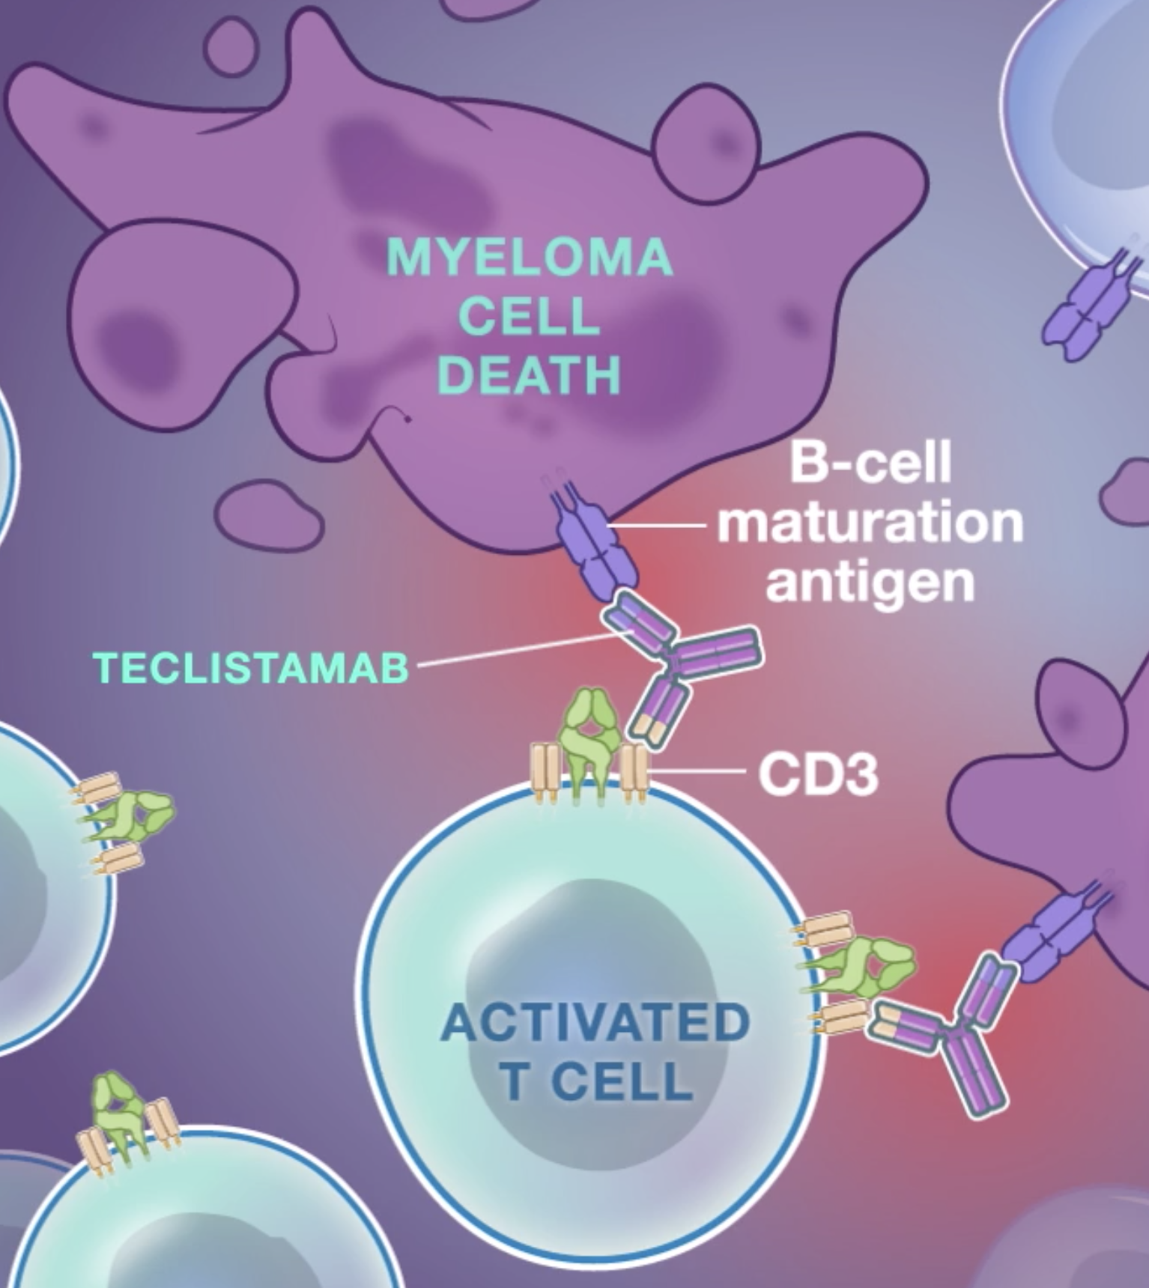
Teclistamab

Slide 29
Dosing regimen, CRS ppx, and hospitalization
Teclistamab SC
Indefinite therapy, 28 day cycles
Step up doses of 0.06mg/kg and 0.3 mg/kg separated by 2-4 days
Teclistamab 1.5mg/kg SC weekly (days 1, 8, 15, 22)
Hospitalization and dexamethasone 16mg for step up doses and first full dose

Slide 30
Trial design and baseline characteristics
 | Teclistamab
Diagnosis | R/R MM, triple-class exposed
Line | 4L
Required prior therapy | IMiD, PI, Anti-CD38
Phase | 2
Duration of therapy | Continuous
Route | SC
Baseline Characteristics
Enrollment | 3/3/20 to 8/13/21
Data Cutoff | 3/16/22
N | 125
Age | 64 (33-83)
Sex | 56%M/44%F
Median prior LOT | 5 (2-14) 78% triple-class refractory 70% penta-drug expose 30% penta-drug refractory
Median time since diagnosis | 6 years (0.8 to 22.7)
High-risk cytogenetics | 26% (16% del(17p) 11% t(4;14) 3% t(14;16))
Prior CAR-T | none
Prior ASCT | 82%

Slide 31
Outcomes and toxicity
Outcomes
Median f/u | 14.1 months
1º | ORR
ORR | 63%
CR | 39%
Median time to response | 1.2 months (0.2 to 5.5)
Median time to best response | 3.8 months (1.1 to 16.8)
mDOR | not yet mature
mPFS | 11.3 months (8.8 to 17.1)
MRD (-) | 27% (46% in pts with CR)
Adverse Events
Any CRS | 72%
G3-4 CRS | 0.6%/0%
G5 CRS | none
Neurotoxicity | 15%
Any ICANS | 3% (5 patients had 9 events)
G3-5 ICANS | none
Anti-IL6 | 36%
Unplanned steroids | 8.50%
Hematologic/Infectious Adverse Events
G3-4 Anemia | 37%
G3-4 Thrombocytopenia | 21%
G3-4 Neutropenia | 64%
G-CSF | 55%
Febrile Neutropenia | 2%
Hypogammaglobulinemia | 75%
IVIg | 39%
Infection | 76% (44% G3-4) 18% COVID19 (7% G5) 4% PJP 1 bacterial meningitis c/b G4 seizure 1 PML 1 G3 adenovirus PNA 1 G4 PML
G-CSF as indicated, consider neutropenia ppx
Consider PJP ppx
Monitor IgG, IVIg as indicated
COVID vaccines and preventative antibodies
Flu, pneumococcal, meningococcal vaccines
?Acyclovir ppx
Screen for HIV/HBV/HCV, strongyloides?

Slide 32
MM BCMA CAR-T and BCMAxCD3 BiTE
 | MM
 | Ide-cel | Cilta-cel | Teclistamab
Trial | KarMMA | CARTITUDE-1 | MagesTEC-1
Target | BCMA | BCMA | BCMA
Line of therapy | 4L | 4L | 4L
Phase | 2 | 2 | 2
N | 128 | 97 | 165
ORR | 78% | 98% | 63%
CR | 33% | 83% | 39%
Any CRS (≥G3) | 84% (5%) | 95% (4%) | 72% (1%)
ICANS (≥G3) | 18% (3%) | 21% (9%) | 3% (0%)

Slide 33
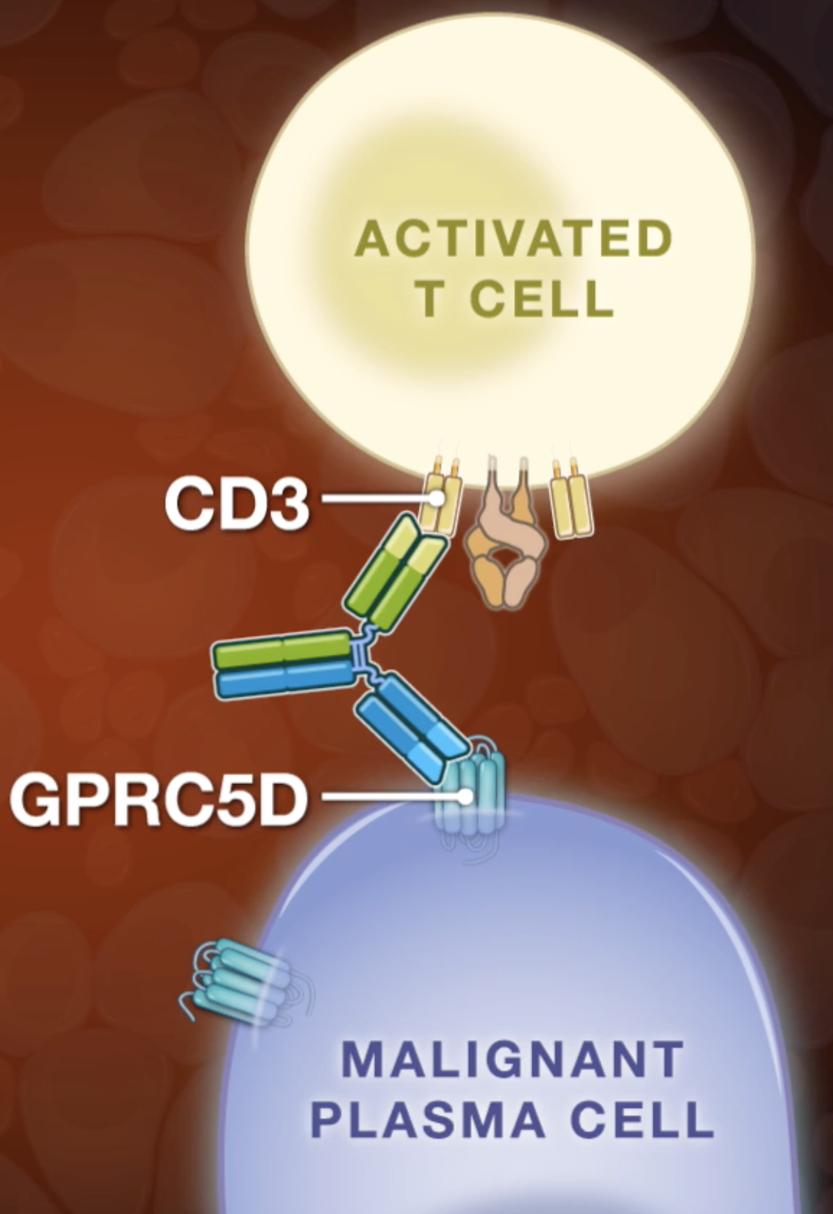
Talquetamab and Cevostamab novel targets

Slide 34
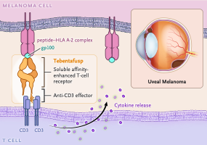
Non-antibody BiTEs in solid tumors
Tebentafusp (gp100xCD3)
Unresectable/metastatic uveal melanoma
FDA approved 1/25/22

Slide 35
Conclusions
BiTEs induced rapid, deep (often MRD-) responses in a subset (~40%) of patients with relapsed/refractory DLBCL (including post-CAR-T), FL, and MM
IV and SC administrations appear to be equally efficacious with similar toxicity
Glofitamab CD20 bivalency doesn’t confer a visible benefit
CR to BiTEs has early durability, but long term durability is yet to be determined, particularly with fixed-duration therapy
Teclistamab may require more intensive infection prophylaxis and treatment
As monotherapy, CD20xCD3 and BCMAxCD3 BiTEs are adjuncts (not alternatives) to CD19 and BCMA CAR-T therapy
Questions
Will BiTEs be tolerable in older frailer patients not fit for CAR-T?
Logistics
Community/university coordination – Initiate therapy at a cell therapy center, then transition to community?
Community training on CRS/ICANS identification and management
REMS certification for each individual drug – there many in the pipeline

